Slide 1
CSCIU 310 01 Introduction to Computer Architecture AKM Jahangir A Majumder, PhD
Spring 2019 - Lecture 3
January 23, 2019
Note: Some slides are adapted from those used by previous instructors and some slides include figures from the textbook.

Slide 2
Review and Learning Outcomes
We review the materials covered in CSCI U 210 last class
We will begin to cover how a datapath is built to implement MIPS instructions.
How to built a Control Signal Generation for data path
Please read the syllabus and sign on the acknowledgement sheet
We will have our first quiz today on MIPS assembly language
HW 2 will post on Blackboard soon
The team project proposal is due today at 5PM
I will be out of town on Feb 6 and Feb 27 for conferences

Slide 3
Anatomy: 5 Components of Any Computer
Personal Computer
Computer
Keyboard, Mouse
Processor
Memory
(where
programs,
data
live when
running)
Devices
Disk (where
programs,
data
live when
not running)
This and
Next few weeks
Control
(“brain”)
Input
Datapath
(“brawn”)
Output
Display, Printer
Notes:
That is, any computer, no matter how primitive or advance, can be divided into five parts:
1. The input devices bring the data from the outside world into the computer.
2. These data are kept in the computer’s memory until ...
3. The datapath request and process them.
4. The operation of the datapath is controlled by the computer’s controller.
All the work done by the computer will NOT do us any good unless we can get the data back to the outside world.
5. Getting the data back to the outside world is the job of the output devices.
The most COMMON way to connect these 5 components together is to use a network of busses.

Slide 4
MIPS Datapath

Slide 5
Review: The MIPS Instruction Formats
All MIPS instructions are 32 bits long. 3 formats:
R-type
I-type
J-type
The different fields are:
op: operation (“opcode”) of the instruction
rs, rt, rd: the source and destination register specifiers
shamt: shift amount
funct: selects the variant of the operation in the “op” field
address / immediate: address offset or immediate value
target address: target address of jump instruction
31
26
21
16
11
6
0
op
rs
rt
rd
shamt
funct
6 bits
5 bits
5 bits
5 bits
5 bits
6 bits
31
26
21
16
0
op
rs
rt
address/immediate
6 bits
5 bits
5 bits
16 bits
31
26
0
op
target address
6 bits
26 bits
Notes:
One of the most important thing you need to know before you start designing a processor is how the instructions look like.
Or in more technical term, you need to know the instruction format. One good thing about the MIPS instruction set is that it is very simple.
First of all, all MIPS instructions are 32 bits long and there are only three instruction formats: (a) R-type, (b) I-type, and (c) J-type.
The different fields of the R-type instructions are:
(a) OP specifies the operation of the instruction.
(b) Rs, Rt, and Rd are the source and destination register specifiers.
(c) Shamt specifies the amount you need to shift for the shift instructions.
(d) Funct selects the variant of the operation specified in the “op” field.
For the I-type instruction, bits 0 to 15 are used as an immediate field. I will show you how this immediate field is used differently by different instructions.
Finally for the J-type instruction, bits 0 to 25 become the target address of the jump.
+3 = 10 min. (X:50)

Slide 6
The MIPS-lite Subset for today
31
26
21
16
11
6
0
ADDU and SUBU
addu rd,rs,rt
subu rd,rs,rt
ADD Immediate:
addi rt,rs,imm16
LOAD and STORE Word
lw rt,rs,imm16
sw rt,rs,imm16
BRANCH:
beq rs,rt,imm16
op
rs
rt
rd
shamt
funct
6 bits
5 bits
5 bits
5 bits
5 bits
6 bits
31
26
21
16
0
op
rs
rt
immediate
6 bits
5 bits
5 bits
16 bits
31
26
21
16
0
op
rs
rt
immediate
6 bits
5 bits
5 bits
16 bits
31
26
21
16
0
op
rs
rt
immediate
6 bits
5 bits
5 bits
16 bits
Notes:
In today’s lecture, I will show you how to implement the following subset of MIPS instructions: add, subtract, or immediate, load, store, branch, and the jump instruction.
The Add and Subtract instructions use the R format. The Op together with the Func fields together specified all the different kinds of add and subtract instructions.
Rs and Rt specifies the source registers. And the Rd field specifies the destination register.
The Or immediate instruction uses the I format. It only uses one source register, Rs. The other operand comes from the immediate field. The Rt field is used to specified the destination register. (Note that dest is the Rt field!)
Both the load and store instructions use the I format and both add the Rs and the immediate filed together to from the memory address.
The difference is that the load instruction will load the data from memory into Rt while the store instruction will store the data in Rt into the memory.
The branch on equal instruction also uses the I format. Here Rs and Rt are used to specified the registers we need to compare.
If these two registers are equal, we will branch to a location offset by the immediate field.
Finally, the jump instruction uses the J format and always causes the program to jump to a memory location specified in the address field.
I know I went over this rather quickly and you may have missed something. But don’t worry, this is just an overview. You will keep seeing these (point to the format) all day today.
+3 = 13 min. (X:53)

Slide 7
Register Transfer Language (Behavioral)
RTL gives the meaning of the instructions {op , rs , rt , rd , shamt , funct} = MEM[ PC ]
{op , rs , rt , Imm16} = MEM[ PC ]
All start by fetching the instruction
inst Register Transfers
ADDU R[rd] = R[rs] + R[rt]; PC = PC + 4
SUBU R[rd] = R[rs] – R[rt]; PC = PC + 4
ADDI R[rt] = R[rs] + sign_ext(Imm16); PC = PC + 4
LOAD R[rt] = MEM[ R[rs] + sign_ext(Imm16)]; PC = PC + 4
STORE MEM[ R[rs] + sign_ext(Imm16) ] = R[rt]; PC = PC + 4
BEQ if ( R[rs] == R[rt] ) then PC = PC + 4 + (sign_ext(Imm16) || 00)
else PC = PC + 4

Slide 8
Requirements of the Instruction Set
Memory (MEM)
instructions & data
Registers (R: 32 x 32)
read RS
read RT
Write RT or RD
PC (program counter)
Extender (sign extend)
Add and Sub register or extended immediate
Add 4 or extended immediate to PC

Slide 9
Components of the Datapath
Combinational Elements
Storage Elements
Clocking methodology

Slide 10
Datapath Building Blocks: Combinational Logic Elements
CarryIn
A
32
Adder
MUX
ALU
Adder
Sum
32
B
CarryOut
32
Select
A
32
MUX
Y
32
B
32
OP
A
32
ALU
Result
32
B
32
Notes:
Based on the Register Transfer Language examples we have so far, we know we will need the following combinational logic elements.
We will need an adder to update the program counter.
A MUX to select the results.
And finally, an ALU to do various arithmetic and logic operation.
+1 = 30 min. (Y:10)

Slide 11
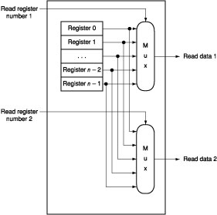
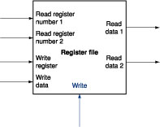
Datapath Building Blocks: Register Files
Built using D flip-flops

Slide 12
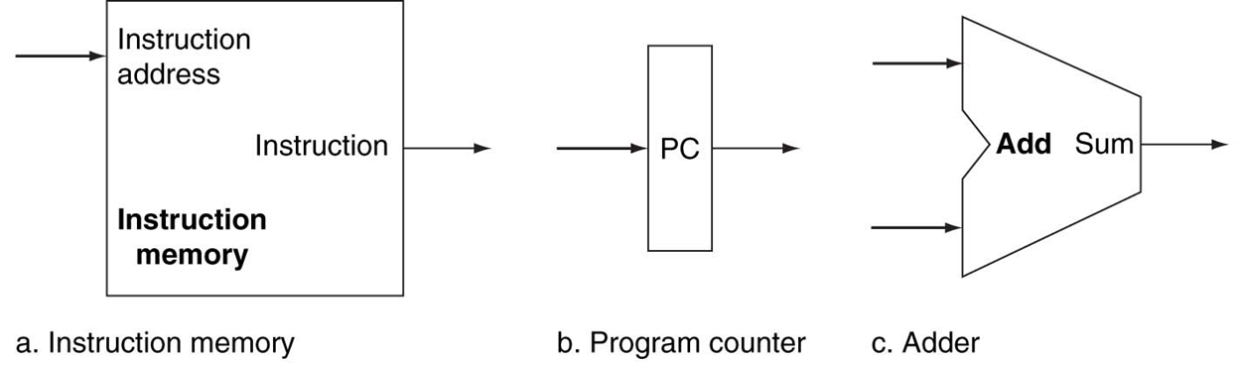
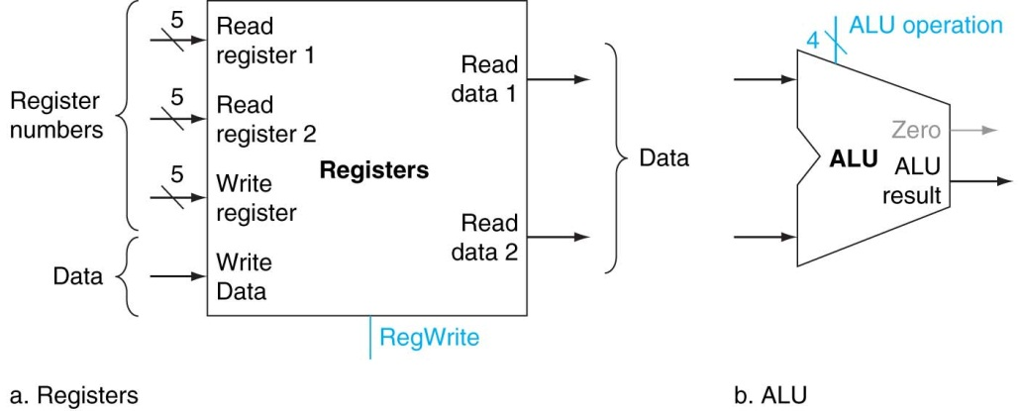
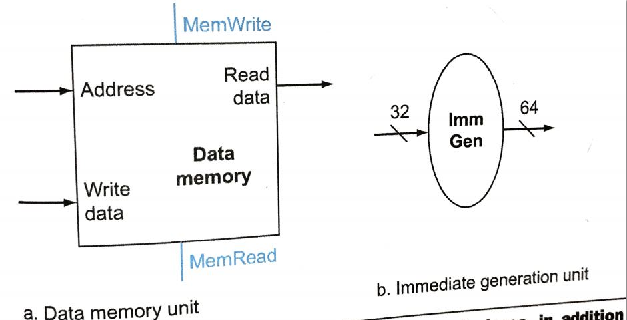
Datapath Building Blocks: PC, Memory, Adder, etc

Slide 13
Overview of the Instruction Fetch Unit
The common RTL operations
Fetch the Instruction: mem[PC]
Update the program counter:
Sequential Code: PC = PC + 4
Branch and Jump: PC = “something else”
Clk
PC
Next Address
Logic
Address
Instruction Word
Instruction
Memory
32
Notes:
Now let’s take a look at the first major component of the datapath: the instruction fetch unit.
The common RTL operations for all instructions are:
(a) Fetch the instruction using the Program Counter (PC) at the beginning of an
instruction’s execution (PC -> Instruction Memory -> Instruction Word).
(b) Then at the end of the instruction’s execution, you need to update the
Program Counter (PC -> Next Address Logic -> PC).
More specifically, you need to increment the PC by 4 if you are executing sequential code.
For Branch and Jump instructions, you need to update the program counter to “something else” other than plus 4.
I will show you what is inside this Next Address Logic block when we talked about the Branch and Jump instructions.
For now, let’s focus our attention to the Add and Subtract instructions.
+2 = 37 min. (Y:17)

Slide 14
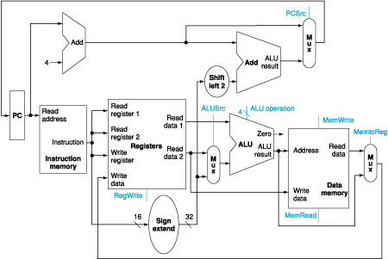
Building the Datapath (for R-Type)
Example: addu $t0, $s1, $s2
31
26
21
16
11
6
0
op
rs
rt
rd
shamt
funct
6 bits
5 bits
5 bits
5 bits
5 bits
6 bits
Fetch Instruction
Read Two Registers
ALU Operation
Write Register

Slide 15
Building the Datapath (for Immediate)
Example: addi $t0, $s1, 100
31
26
21
16
0
op
rs
rt
immediate
6 bits
5 bits
5 bits
16 bits
Fetch Instruction
Read One Register
Signed extend immediate
Calculation Result
Read Data from Memory
Write Register

Slide 16
Question
How can the ‘rt’ field be used for specifying the register to read in one case and for specifying the register to write in another case?
31
26
21
16
11
6
0
op
rs
rt
rd
shamt
funct
6 bits
5 bits
5 bits
5 bits
5 bits
6 bits
31
26
21
16
0
op
rs
rt
immediate
6 bits
5 bits
5 bits
16 bits

Slide 17
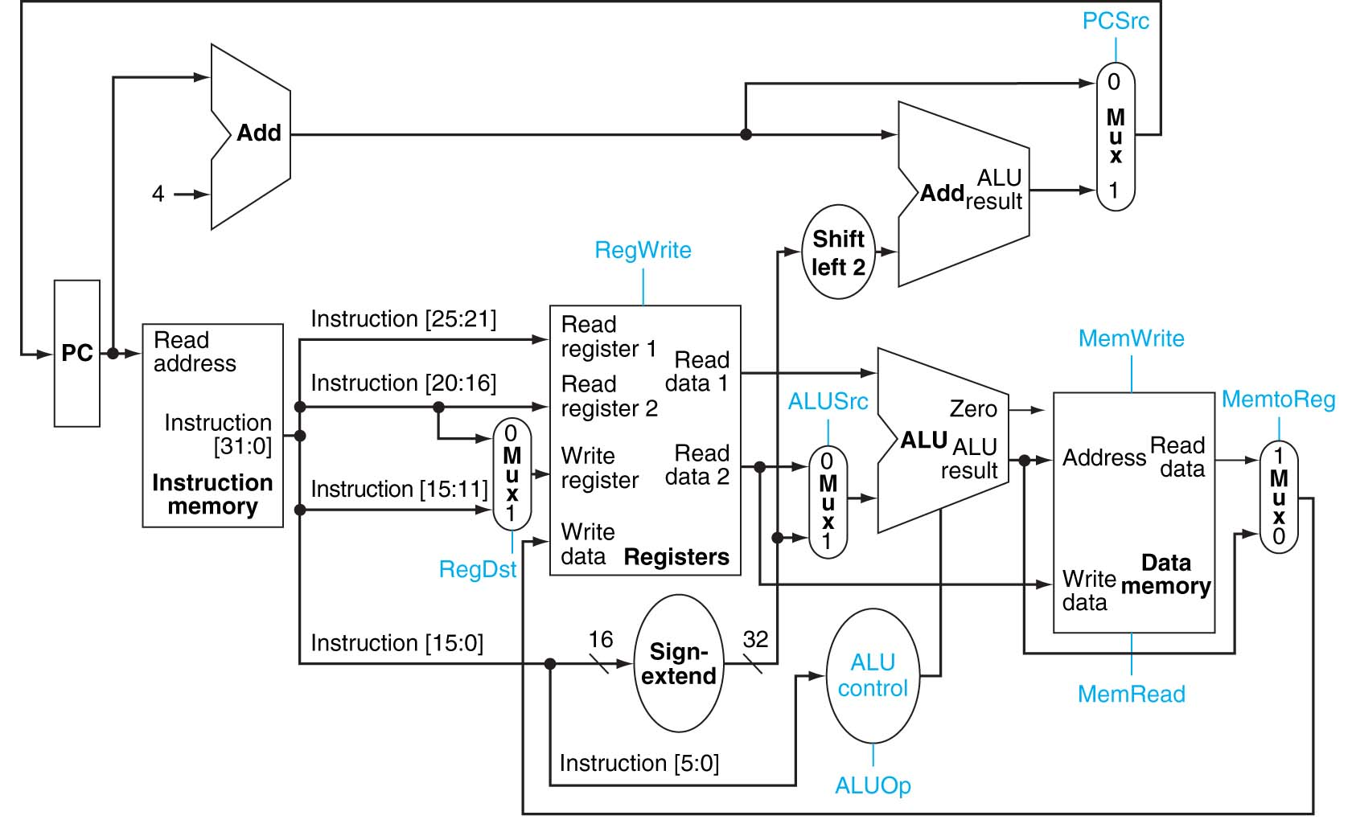
Solution

Slide 18
Summary
Today, we started a very simple datapath design which implements all instructions in one clock cycle.
The datapath presented today has two memory segments: one for instruction and one for data and two ALUs: one for operation and one for PC increment.
Later, we are going to cover multi-cycle datapath design which only has one ALU and one memory segment and take more than one clock cycle to finish one instruction.
We also covered the following two topics:
how the control signal can be generated in a processor
issues of single cycle processor.

